Slide 1
Introduction to Android Programming
G. P. Shinde

Slide 2
Android Its Features, API Levels and Versions
What is Android?
Android is an open-source and Linux-based operating system.
It was first introduced on Nov 5, 2007.
It was originally developed by Android Inc. and subsequently purchased by Google.
Android provides a rich application framework that allows us to build innovative apps and games for mobile devices in a Java language environment.
Android is thought of as a mobile operating system. But it is not limited to mobile-only. It is currently used in various devices such as mobiles, tablets, televisions, etc.

Slide 3
Android Its Features, API Levels and Versions
Why Android?
Zero/negligible development cost
The development tools like Android SDK, JDK, and Eclipse IDE, etc. are free to download for the android mobile application development.
Google charges a small fee of $25, to distribute your mobile app on the Android Market.
Open Source
The Android OS is an open-source platform based on the Linux kernel and multiple open-source libraries.
Multi-Platform Support
In the market, there is a wide range of hardware devices powered by the Android OS, including many different phones and tablets. Even the development of android mobile apps can occur on Windows, Mac OS, or Linux.
Multi-Carrier Support
World wide a large number of telecom carriers like Airtel, Vodafone, Idea Cellular, AT&T Mobility, BSNL, etc.

Slide 4
Features of Android
Connectivity
Android supports multiple connectivity technologies including GSM/EDGE, IDEN, CDMA, EV-DO, UMTS, Bluetooth, Wi-Fi, LTE, NFC, and WiMAX
Media support
Android supports various types of audio/video/still media formats like H.263, H.264, MPEG-4 SP, AMR, AMR-WB, AAC, HE-AAC, AAC 5.1, MP3, MIDI, Ogg Vorbis, WAV, JPEG, PNG, GIF, BMP and WebP
Web browser
The web browser available in Android is based on the open-source Blink (previously WebKit) layout engine, coupled with Chrome's V8 JavaScript engine supporting HTML5 and CSS3.

Slide 5
Features of Android
Messaging
SMS and MMS are available forms of messaging
Multi-tasking
Multitasking of applications, with unique handling of memory allocation, is available, using this users can jump from one task to another and at the same time various applications can run simultaneously
Multi-Language
Android supports multiple languages, also supports the single direction and bi-directional text

Slide 6
API Levels and Versions
Application program interface (API) is a code for a programmer that they use in their applications.
New APIs are developed as the development is going on with new features and functions in Android devices. Every new Android version introduces a new change that leads to more secure and high-performance improvements.
Android Version | API Level / SDK | Version Name
Android 1 | Android 1.0 | BASE 2008
 | Android 1.1 | BASE_1.1
 | Android 1.5 | CUPCAKE
 | Android 1.6 | DONUT

Slide 7
API Levels and Versions
These are the outdated version of android google has been stop use of these versions or API
Android Version | API Level / SDK | Version Name
Android 2 | Android 2.0 | ÉCLAIR 2009
 | Android 2.2 | FROYO
 | Android 2.3.0 | GINGERBREAD 2010
Android 3 | Android 3.0 | HONEYCOMB
Android 4(2011) | Android 4.0 | ICE_CREAM_SANDWICH

Slide 8
API Levels and Versions
Android Version | API Level / SDK | Version Name
Android 4 | Android 4.1 | JELLYBEAN 2012
 | Android 4.4 | KITKAT 2013
Android 5 | Android 5.0 | LOLLIPOP 2014
Android 6 | Android 6.0 | Marshmallow 2015
Android 7 | Android 7.0 | Nougat 2016
Android 8 | Android 8.0 | Oreo 2017
Android 9 | Android 9.0 | Pie 2018
Android 10 | Android 10 | Quince Tart 2019
Android 11 | Android 11 | Red Velvet Cake 2020
Android 12
Snow Cone
2021
Android 13
Tiramisu
2022
Android 14
TBD

Slide 9
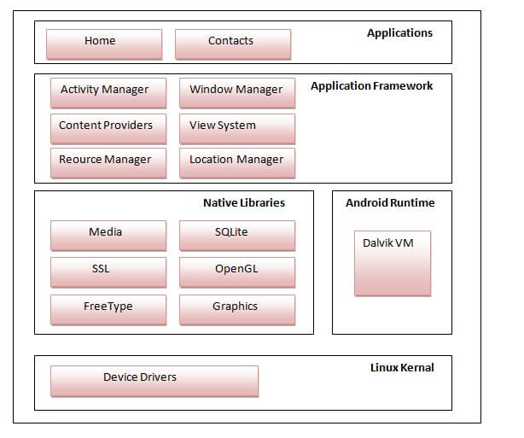
Android Architecture
android architecture or Android software stack is categorized into five parts:
linux kernel
native libraries (middleware),
Android Runtime
Application Framework
Applications

Slide 10
Android Architecture
Linux Kernel
Linux Kernel is heart of the android architecture. It manages all the available drivers such as display drivers, camera drivers, Bluetooth drivers, audio drivers, memory drivers, etc. which are required during the runtime.
The features of Linux kernel are:
Security: The Linux kernel handles the security between the application and the system.
Memory Management: It efficiently handles the memory management thereby providing the freedom to develop our apps.
Process Management: It manages the process well, allocates resources to processes whenever they need them.
Network Stack: It effectively handles the network communication.
Driver Model: It ensures that the application works properly on the device and hardware manufacturers responsible for building their drivers into the Linux build.

Slide 11
Android Architecture
Platform libraries –
The Platform Libraries includes various C/C++ core libraries and Java based libraries such as Media, Graphics, Surface Manager, OpenGL etc. to provide a support for android development.
Media library provides support to play and record an audio and video formats.
Surface manager responsible for managing access to the display subsystem.
SGL and OpenGL both cross-language, cross-platform application program interface (API) are used for 2D and 3D computer graphics.
SQLite provides database support and FreeType provides font support.
Web-Kit This open source web browser engine provides all the functionality to display web content and to simplify page loading.
SSL (Secure Sockets Layer) is security technology to establish an encrypted link between a web server and a web browser.

Slide 12
Android Architecture
Application runtime –
Android Runtime environment is one of the most important part of Android. It contains components like core libraries and the Dalvik virtual machine(DVM). Mainly, it provides the base for the application framework and powers our application with the help of the core libraries.
Application framework –
Application Framework provides several important classes which are used to create an Android application. It provides a generic abstraction for hardware access and also helps in managing the user interface with application resources.
Applications –
Applications is the top layer of android architecture. The pre-installed applications like home, contacts, camera, gallery etc and third party applications downloaded from the play store like chat applications, games etc.

Slide 13
JVM, DVM, ART, DEX
Java Virtual Machine | JVM
To maintain the platform independency of the code, JAVA developed JVM i.e. Java Virtual Machine
JVM is platform dependent and different implementations are available for specific platforms.
JVM uses JIT compiler.
Java bytecode can be run on any machine capable of running JVM.
In JVM, The Java compiler converts the .java files into .class files, which is called bytecode.
This bytecode is given to the JVM which converts it into machine code.

Slide 14
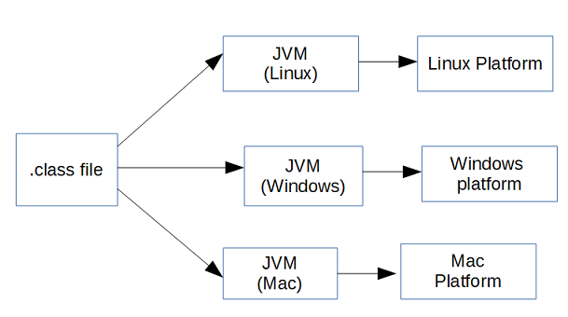
JVM, DVM, ART, DEX

Slide 15
JVM, DVM, ART, DEX
Dalvik Virtual Machine | DVM
Android runtime (ART) is the managed runtime used by applications and some system services on Android. ART and its predecessor Dalvik were originally created specifically for the Android project. ART and Dalvik are compatible runtimes running Dex bytecode
DVM is stands for ‘Delvik Virtual Machine’
DVM (Dalvik Virtual Machine) was created by Dan Bornstein and his team, keeping in mind only the constraints of a mobile device.
It was a purpose specific VM and was strictly created for mobile devices.
Similarly to JVM, it also uses the JIT compiler.
Since everything in mobiles is very limited whether it would be a battery life, processing and memory etc. It had been optimised so that it can fit in with low-powered devices.
In DVM, everything is same as JVM except last two steps here. The Dex compiler converts the class files into the .dex file that run on the Dalvik VM. Multiple class files are converted into one dex file.

Slide 16
JVM, DVM, ART, DEX

Slide 17
Creating First Android Application
Step 1: Open Android Studio
Step 2: Close existing open android project
File->Close Project
Step 3: Choose New Project From Welcome Screen of android Studio.
Step 4: Choose Empty Activity from activity list and click next
Step 5: Set the name to your project
1]Name Cannot Start from any number and special character.
2]Name cannot use blank space instead of this you can use _
(undercore sign)
3]Name first letter must be capital letter.

Slide 18
Creating First Android Application
Step 6: package and save location remain same if you don’t want to change.
Step 7: Select language as Kotlin
Step 8: Choose Minimum SDK Version as JellyBean 4.1.
Step 9: Click on Finish Button
Step 10: Please Wait for few Minute to load android project area
make sure your connected to the internet connection.

Slide 19
Thank You!

